Slide 1

BESTIFUTE FOOTBALL DATABASE
“TO SCORE THE BEST GOAL”
Notes:
Good morning, today we are going to present Bestifute, the best football database that you club can find in the market

Slide 2

INTRODUCTION
The right player can turn a mediocre team into an unstoppable force while spending big can produce disappointing results
Notes:
First, we want to give some context on why you'd want to have your own football database. As you know, the football market has been growing significantly in the recent years. With television revenue, external investment and changes in clubs mindsets, everyone wants the players to assemble the team that wins it all, but also with the growth of social media, having the right player could also mean big revenue from selling tickets shirts and other merchandise

Slide 3
THE FOOTBALL MARKET GROWTH
source: transfermarkt.pt
Notes:
If we look into the past three decades, we instantly notice that the 3 most expensive transfers each decade surpasses the top transfer of the previous one, with the most expensive of the last decade surpassing 220 million euros

Slide 4
THE FOOTBALL MARKET GROWTH
source: transfermarkt.pt
Notes:
Looking at the top transfers of the past 15 years, althought we don't see every year breaking the previous one, we see a clear upward tendency on the transfer fee of the top players. Not only that we can see that after a record breaking transfer, the years that follow have more expensive transfers, as clubs that sell the player receive a large sum of money they can now spend, as well as the other clubs become less afraid of spending big

Slide 5
THE FOOTBALL MARKET GROWTH
source: transfermarkt.pt
Notes:
If we look into the transfers above 50 M€, we notice that before the record breaking season 13/14 they were quite rare, but after the signing of 3 players in the same year above that fee, they are becoming more common each year. It is also important to notice that getting the next big star is also starting to be very competitive, as players under 23 that play on the main team are being sold above 50 million also, so finding them before they make their dobut could be the difference between buying for few thousand or getting a multimillionaire fee

Slide 6

source: FOOTBALL OBSERVATORY REPORT
6622 M€
Is the total investment in player transfers in the top 5 leagues (2019)
Notes:
At last, if we look into the top five leagues (Spanish, English, German, Italian, and French), we notice that their total investment was above 6 thousand million euros.

Slide 7
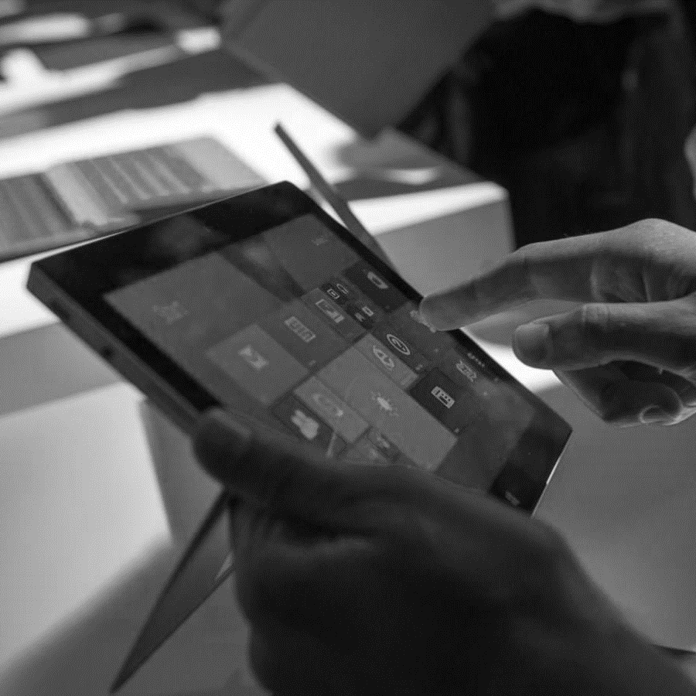
We created an app that allows clubs to easily create and search their own database of players
THE BESTIFUTE DATABASE

Slide 8



OUR SOLUTION
/ INFORMATION
/ COMMUNICATION
Unique database that combines financial and performance data
Facilitate information transfer between all parties involved
/ CUSTOMIZATION
/ CENTRALIZATION
Coaches adapt player requirements to their club’s needs
Allow scouts and agents to share information with multiple clubs

Slide 9




WHO INTERACTS WITH THIS APP?
/ COACH
/ SPORTING DIRECTOR
/ SCOUT
/ AGENT
Defines Performance Requirements
Negotiates Club’s finances
Rates Players
Negotiates Player’s finances

Slide 10


CASE STUDY
/ BUDGET
10M
30k€
/wk
Maximum Fee
Maximum Wage
JORGE JESUS
FOOTBALL MANAGER
/ PLAYER REQUIREMENTS
MF
Strong
Hard Worker

Slide 11
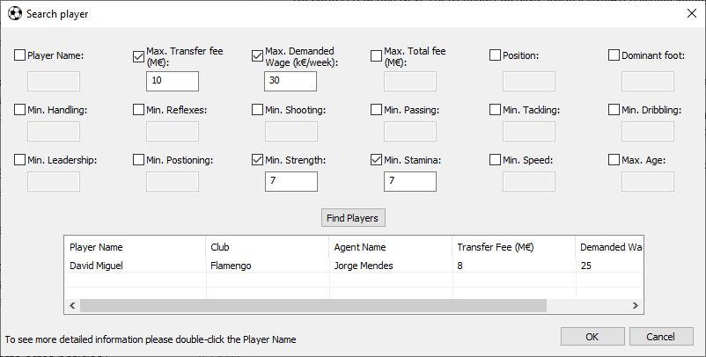
SEARCH FUNCTION

Slide 12
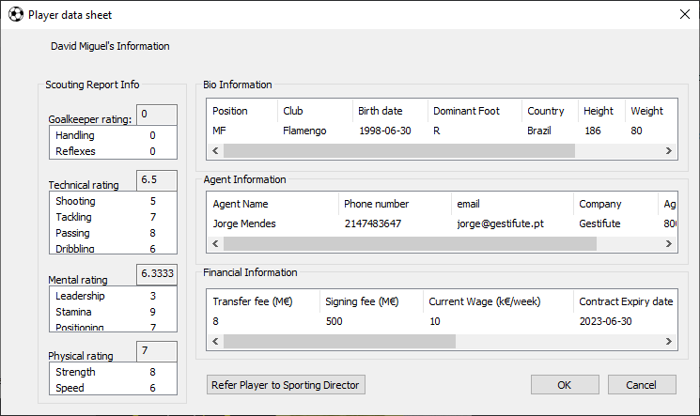
SEARCH FUNCTION

Slide 13
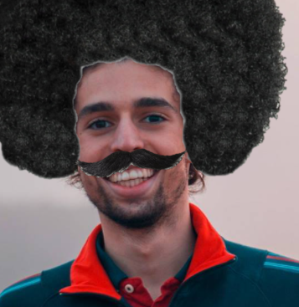

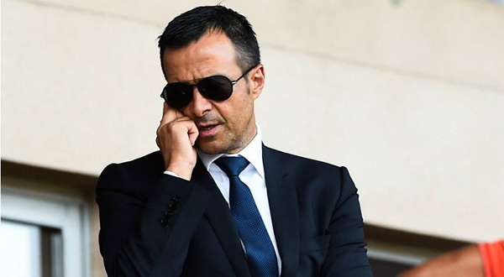
DATABASE INFORMATION
/ MANUEL SILVA
SCOUT
JORGE MENDES /
AGENT
/ DAVID MIGUEL
PLAYER
Scouting Report
Financial Report
Fits coach requirements

Slide 14
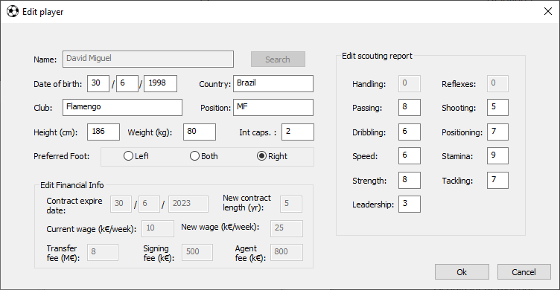
DATABASE INFORMATION
/ MANUEL SILVA
SCOUT
JORGE MENDES /
AGENT
Scouting Report

Slide 15
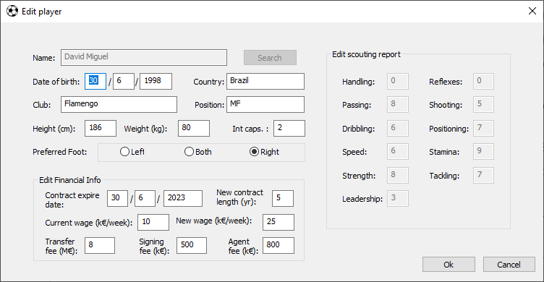
DATABASE INFORMATION
/ MANUEL SILVA
SCOUT
JORGE MENDES /
AGENT
Financial Report

Slide 16
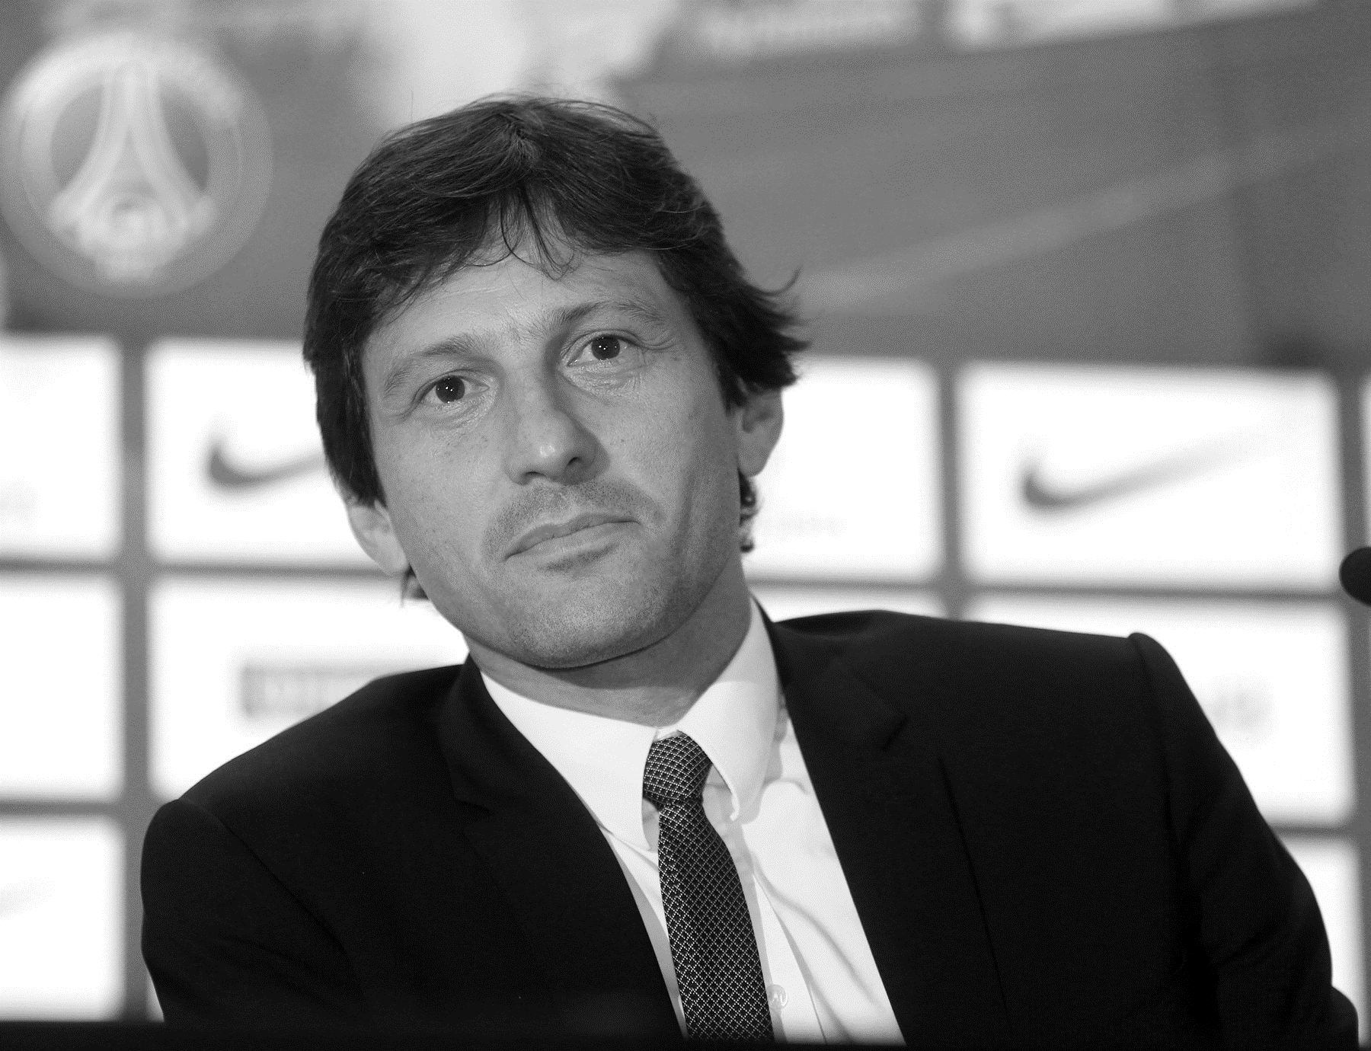
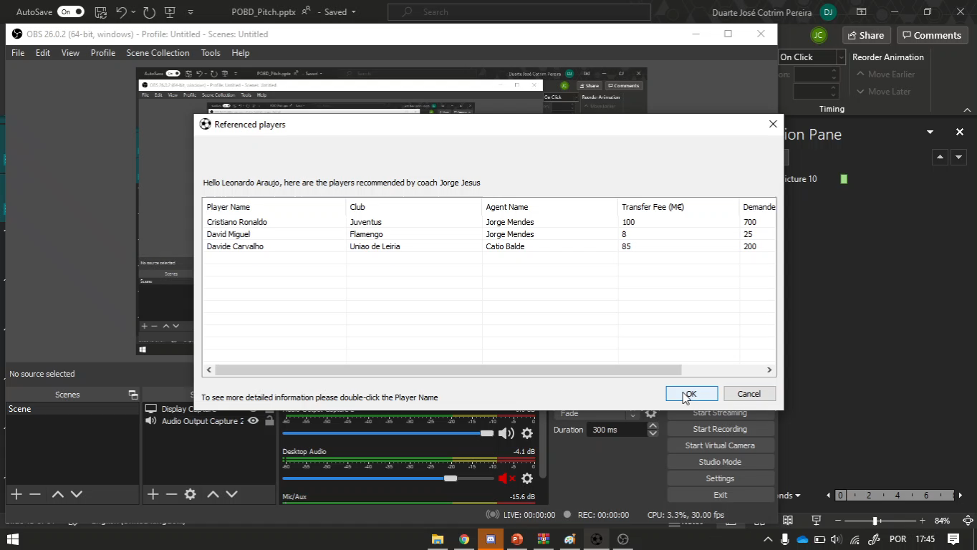
REFERENCED PLAYERS
LEONARDO ARAUJO
SPORTING DIRECTOR

Slide 17
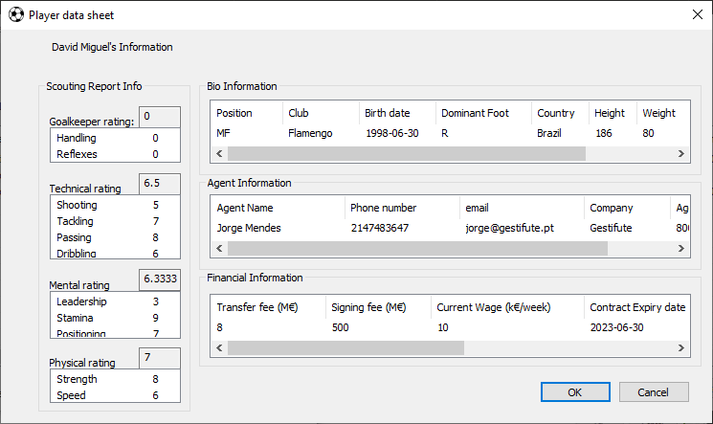
REFERENCED PLAYERS
LEONARDO ARAUJO
SPORTING DIRECTOR
Negotiations can proceed!

Slide 18




FUTURE DEVELOPMENTS
/ 02
/ 04
Interface to add Scouts/S. Director/Agent/Coach
Database Enrichment by Client network expansion
/ 01
/ 03
Aditional Search Features
Player Statistics Complementation through Data Science

Slide 19
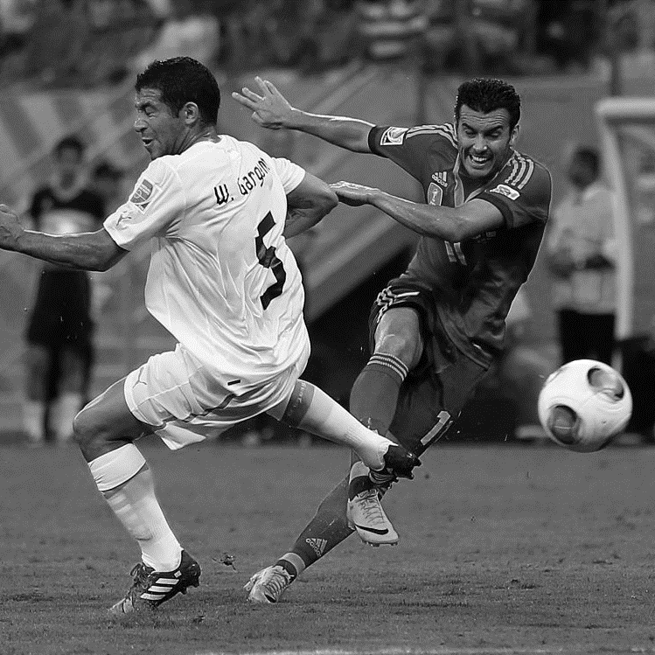


THANKS!
DO YOU HAVE ANY QUESTIONS?
Bruno Cotrim 87159
Duarte Pereira 87180
José Trigueiro 87225
Please keep this slide for attribution

